Slide 1
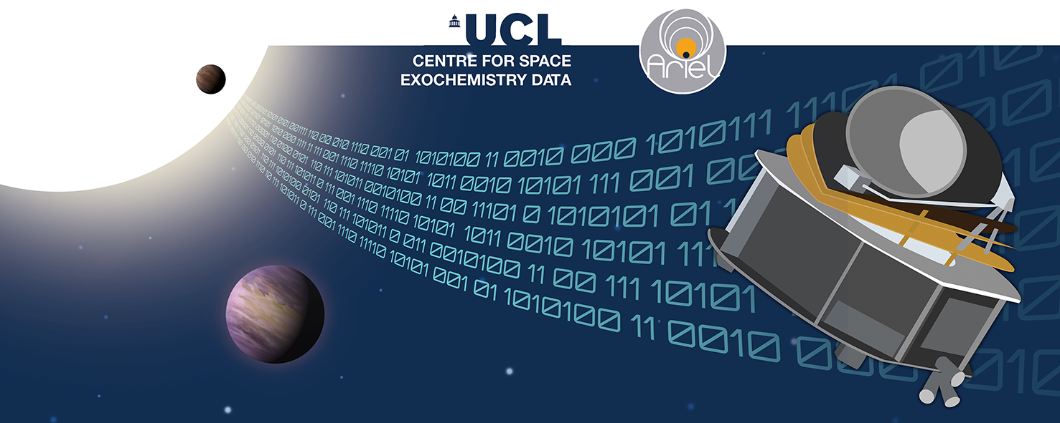
Lecture 2: Official Solution Walkthrough
Tutorials: NeurIPS - Ariel Data Challenge 2024
Presenter: kaggle君-sakura（bili_sakura@zju.edu.cn）
Date: October 9, 2024
Image Credit: NeurIPS - Ariel Data Challenge 2024 | Kaggle
© kaggle君-sakura, 2024. All rights reserved.

Slide 2
Outline
Recall the Task for Ariel Data Challenge
Calibration Details
Fundamentals
Explanation on Official Baseline Solution
Data Preparation
1D-CNN for mean transit depth
2D CNN for atmospheric features
Results
Insights (See Lecture 3)
Possible Tricks for Baseline Improvement
DL-Tech1 : End-to-End Transformer-Based Solution
DL-Tech2 : Consider 3D Convolutional Module
© kaggle君-sakura, 2024. All rights reserved.

Slide 3
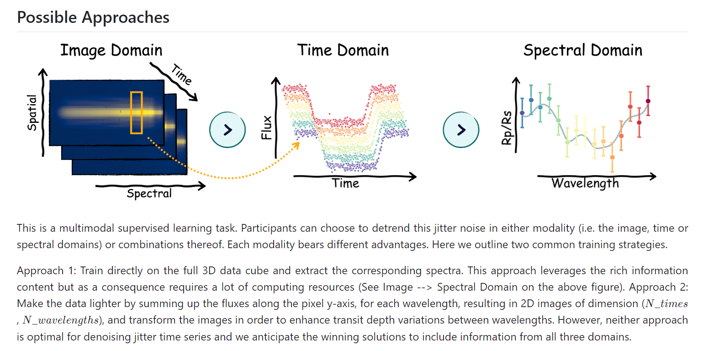
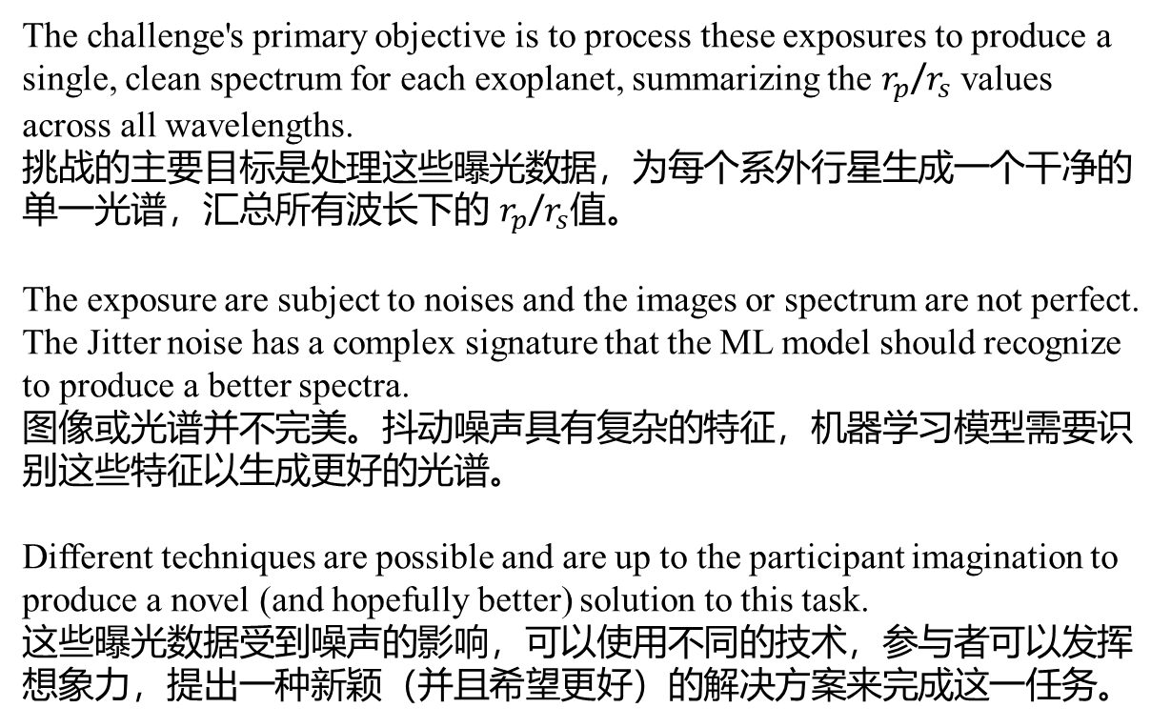
Recall the Task for Ariel Data Challenge
The challenge's primary objective is to process these exposures to produce a single, clean spectrum for each exoplanet, summarizing the $r_{p}$/$r_{s}$ values across all wavelengths.
挑战的主要目标是处理这些曝光数据，为每个系外行星生成一个干净的单一光谱，汇总所有波长下的 $r_{p}$/$r_{s}$值。
The exposure are subject to noises and the images or spectrum are not perfect. The Jitter noise has a complex signature that the ML model should recognize to produce a better spectra.
图像或光谱并不完美。抖动噪声具有复杂的特征，机器学习模型需要识别这些特征以生成更好的光谱。
Different techniques are possible and are up to the participant imagination to produce a novel (and hopefully better) solution to this task.
这些曝光数据受到噪声的影响，可以使用不同的技术，参与者可以发挥想象力，提出一种新颖（并且希望更好）的解决方案来完成这一任务。
© kaggle君-sakura, 2024. All rights reserved.

Slide 4
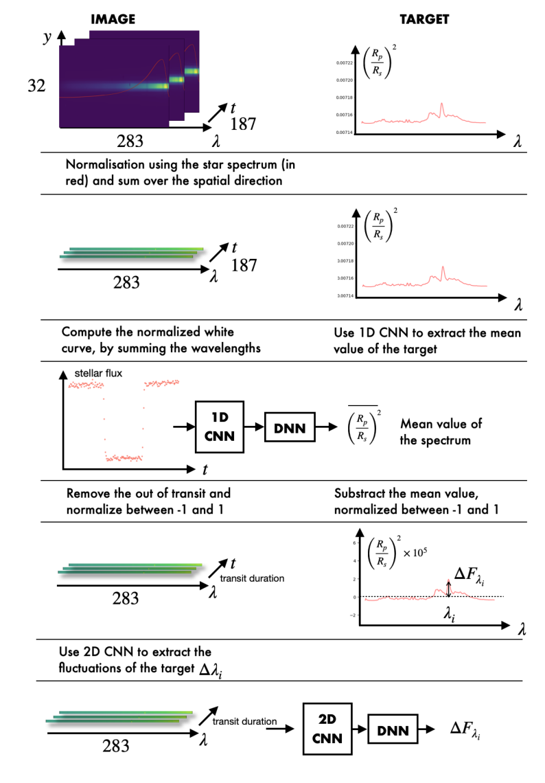
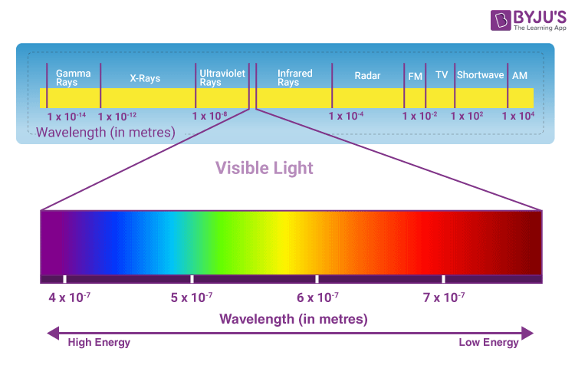
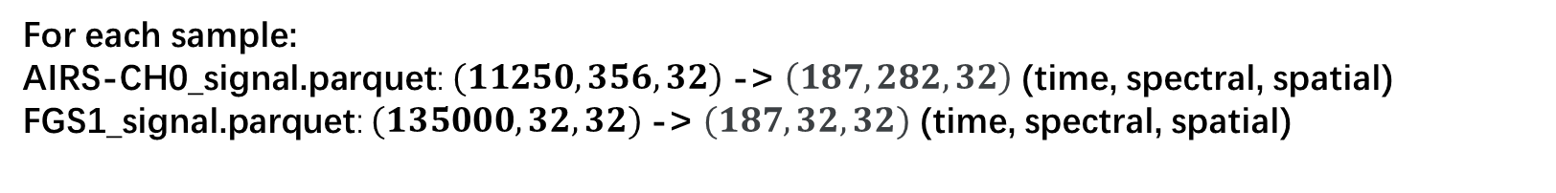
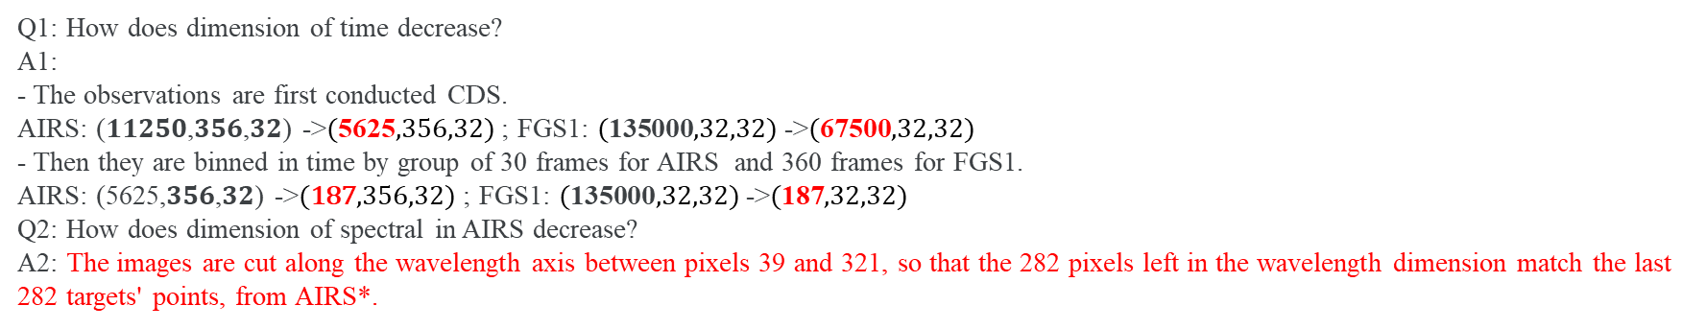
Calibration
For each sample:
AIRS-CH0_signal.parquet: $(11250,356,32)$-> $\left(187, 282, 32\right)$ (time, spectral, spatial)
FGS1_signal.parquet: $(135000,32,32)$-> $(187, 32, 32)$ (time, spectral, spatial)
Calibrating and Time Binning Astronomical Data 校准和时间分箱天文数据
Step 1: Analog-to-Digital Conversion 模拟到数字转换
Step 2: Mask hot/dead Pixel 屏蔽热像素/坏像素
Step 2: Linearity Correction 线性校正
Step 3: Dark Current Subtraction 暗电流扣除
Step 4: Get Correlated Double Sampling (CDS) 获取相关双重采样
Step 5 (Optional): Time Binning 时间分箱
Step 6: Flat Field Correction 平场校正
AIRS-CH0: 1.95 - 3.90 µm
FGS1: 0.60 – 0.80 µm
Q1: How does dimension of time decrease?
A1:
- The observations are first conducted CDS.
AIRS: (𝟏𝟏𝟐𝟓𝟎,𝟑𝟓𝟔,𝟑𝟐) ->$(\text{5625},356,32)$; FGS1: $(\text{135000},32,32)$->$(\text{67500},32,32)$
- Then they are binned in time by group of 30 frames for AIRS and 360 frames for FGS1.
AIRS: (5625,𝟑𝟓𝟔,𝟑𝟐) ->$(\text{187},356,32)$; FGS1: $(\text{135000},32,32)$->$(\text{187},32,32)$
Q2: How does dimension of spectral in AIRS decrease?
A2: The images are cut along the wavelength axis between pixels 39 and 321, so that the 282 pixels left in the wavelength dimension match the last 282 targets' points, from AIRS*.
I think this mapping by cropping is confusing. We would find a way to match $N_{spectral}=356 →N_{spectral}=282$
* https://www.kaggle.com/code/gordonyip/update-calibrating-and-binning-astronomical-data/comments#2953798
Image Credit: https://byjus.com/physics/visible-light/
© kaggle君-sakura, 2024. All rights reserved.

Slide 5
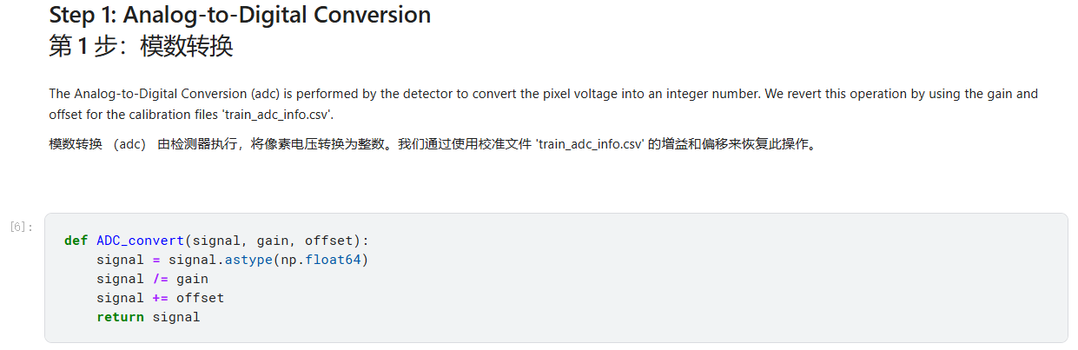
Calibration
There are some things you should pay attention to/modify in official calibration notebook:
Note we divide gain as the gain provided is an inversion factor of a standard gain.
See * for more explanation.
*https://www.kaggle.com/code/gordonyip/update-calibrating-and-binning-astronomical-data/comments#2951175
© kaggle君-sakura, 2024. All rights reserved.

Slide 6
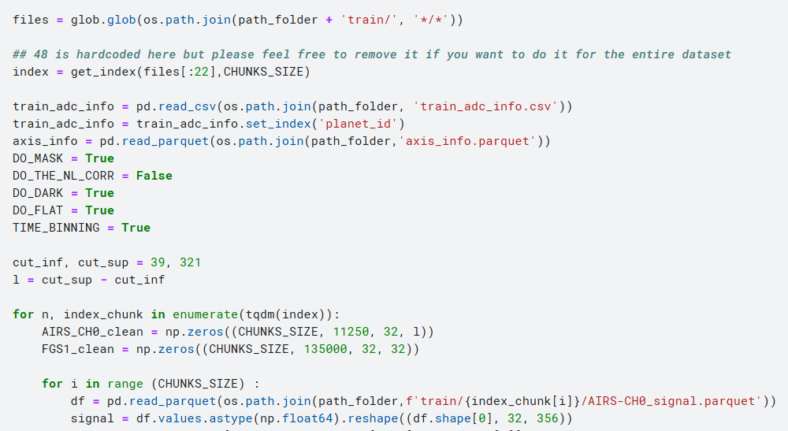
Calibration
There are some things you should pay attention to/modify in official calibration notebook:
1. Default CHUNKS_SIZE=1, enlarge it for acceleration.
2. Replace “[:22]” with “[:]” to process all data in “train” folder. If you want to do a subset, the index number should be 4 × sample_number. In other words, “[:]” works the same as “[:4*673]” where 673 is the number of samples in “train” folder.
3. As mentioned previously, this cropping for AIRS_CH0 data in spectrum dimension is confusing. Use other way instead.
https://www.kaggle.com/code/gordonyip/update-calibrating-and-binning-astronomical-data/comments#2948491
https://www.kaggle.com/code/gordonyip/update-calibrating-and-binning-astronomical-data/comments#2957303
© kaggle君-sakura, 2024. All rights reserved.

Slide 7
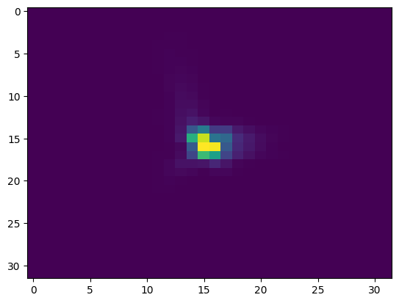
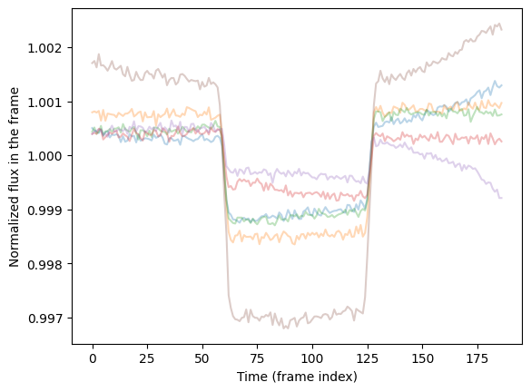
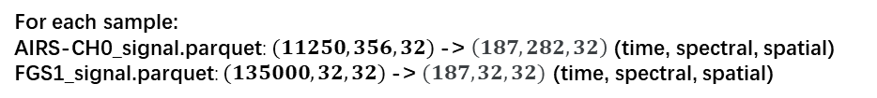
Calibration
For each sample:
AIRS-CH0_signal.parquet: $(11250,356,32)$-> $\left(187, 282, 32\right)$ (time, spectral, spatial)
FGS1_signal.parquet: $(135000,32,32)$-> $(187, 32, 32)$ (time, spectral, spatial)
plt.imshow(data_train_FGS[-1,50,:,:].T, aspect = 'auto')
6 samples of AIRS-CH0 are displayed.
An image-like slice from FGS1 sample data, where time_frame=50. X-axis denotes spectral dimension while Y-axis denotes spatial dimension.
Visualization of calibrated data.
© kaggle君-sakura, 2024. All rights reserved.

Slide 8

For FGS1 spectral dimension, the official solution seems to use average 32 channel, which ranges from 0.6 μm to 0.8 μm, to match the target wavelength i.e. 0.705 μm. This is also confusing. Check it on your own, and you may refer to comments or other people’s solution to find a better way out.
Data Preparation
For each sample:
AIRS-CH0_signal.parquet: $(11250,356,32)$-> $\left(187, 282, 32\right)$ (time, spectral, spatial)
FGS1_signal.parquet: $(135000,32,32)$-> $(187, 32, 32)$ (time, spectral, spatial)
$(187, 1, 32)$
Concatenate by spectral dimension
© kaggle君-sakura, 2024. All rights reserved.

Slide 9
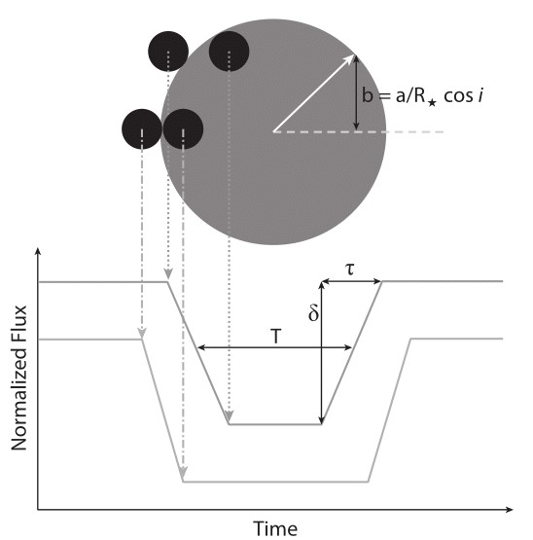
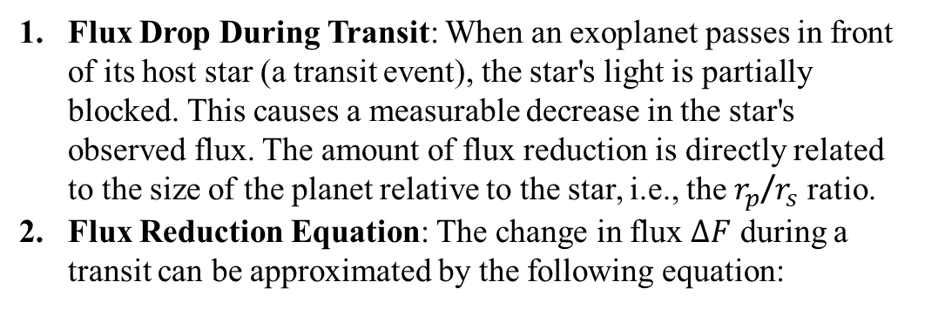

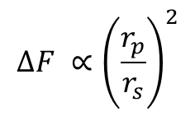
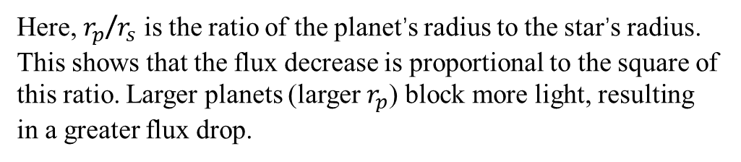
Fundamentals of Transits
Following are astrophysics theorem only.
Flux Drop During Transit: When an exoplanet passes in front of its host star (a transit event), the star's light is partially blocked. This causes a measurable decrease in the star's observed flux. The amount of flux reduction is directly related to the size of the planet relative to the star, i.e., the $r_{p}$/$r_{s}$ ratio.
Flux Reduction Equation: The change in flux $ΔF$ during a transit can be approximated by the following equation:
$$ΔF ∝{\left.\left(\frac{r_{p}}{r_{s}}\right.\right)}^{2}$$
Here, $r_{p}$/$r_{s}$​​ is the ratio of the planet’s radius to the star’s radius. This shows that the flux decrease is proportional to the square of this ratio. Larger planets (larger $r_{p}$) block more light, resulting in a greater flux drop.
Theoretical transiting exoplanet light curve. This image shows the transit depth (δ), transit duration (T), and ingress/egress duration (τ) of a transiting exoplanet relative to the position that the exoplanet is to the star.
在系外行星的凌星过程中，恒星的光通量（flux）与恒星半径 $r_{s}$和行星半径 $r_{p}$ 的比值 $r_{p}$/$r_{s}$​ 有着直接关系。这种关系是凌星光度法中推断行星大小的重要基础。
此处，光通量即对y轴（空间轴）像素值（光强）求和得到。
© kaggle君-sakura, 2024. All rights reserved.

Slide 10
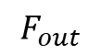
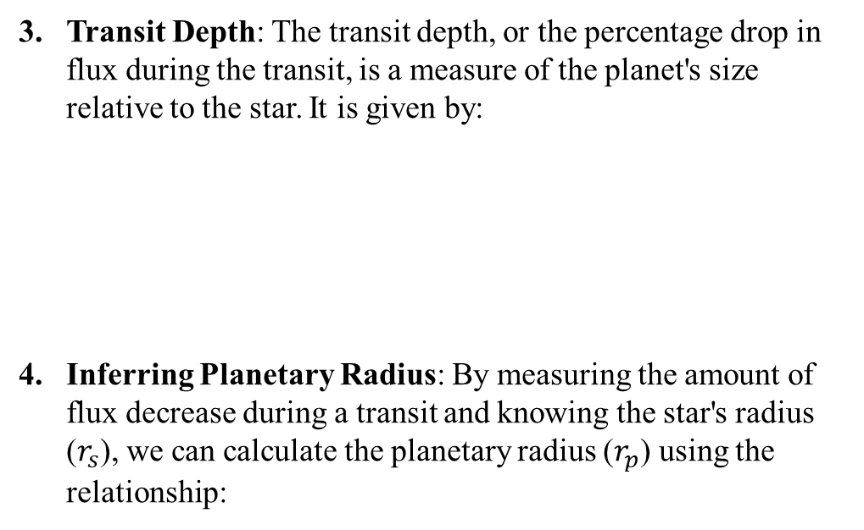
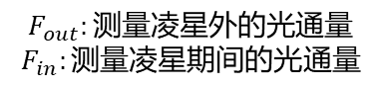
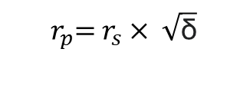
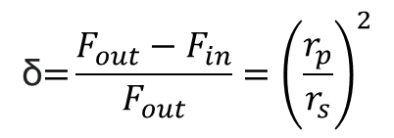
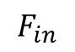
Fundamentals of Transits
Transit Depth: The transit depth, or the percentage drop in flux during the transit, is a measure of the planet's size relative to the star. It is given by:
Inferring Planetary Radius: By measuring the amount of flux decrease during a transit and knowing the star's radius ($r_{s}$), we can calculate the planetary radius ($r_{p}$​) using the relationship:
凌星深度： 凌星深度，或在凌星期间光通量下降的百分比，可以表示为：
$$\text{δ}\text{=}{\left.\frac{F_{out}−F_{in}}{F_{out}}=\left(\frac{r_{p}}{r_{s}}\right.\right)}^{2}$$
metric (%)
$$F_{out}:\text{测量凌星外的光通量}$$
$$F_{in}:\text{测量凌星期间的光通量}$$
For example, if a planet is 10% the size of its star, the flux will drop by approximately 1% during the transit.
$$F_{out}$$
$$F_{in}$$
推断行星半径： 通过测量凌星期间的光通量下降量并已知恒星的半径 $r_{s}$​，可以使用以下关系计算出行星的半径 $r_{p}$​：
$$r_{p}\text{​}\text{=} r_{s}× \sqrt{\text{δ}}$$
​
Theoretical transiting exoplanet light curve. This image shows the transit depth (δ), transit duration (T), and ingress/egress duration (τ) of a transiting exoplanet relative to the position that the exoplanet is to the star.
物理模型的基础： 该模型还假设行星和恒星之间的距离相对较大，以至于我们可以将行星和恒星视为两个圆盘（视角内的圆）。在这种假设下，行星的投影面积和恒星的投影面积的比值决定了凌星期间光通量的变化。
理想情况假设： 这种物理模型假设恒星是均匀发光的，即恒星表面每个区域的亮度相同。在现实中，恒星的亮度分布可能会因为边缘昏暗效应（Limb Darkening）而略有变化，但这个模型提供了一个很好的近似。
© kaggle君-sakura, 2024. All rights reserved.

Slide 11
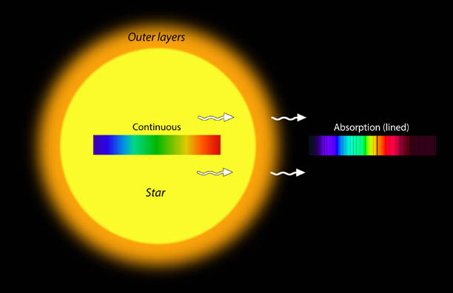
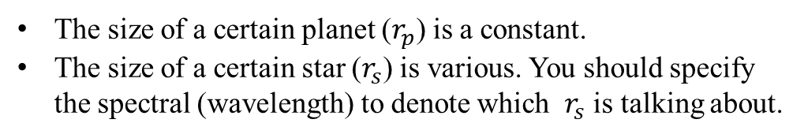
Fundamentals of Transits
The size of a certain planet ($r_{p}$) is a constant.
The size of a certain star ($r_{s}$) is various. You should specify the spectral (wavelength) to denote which $r_{s}$ is talking about.
© kaggle君-sakura, 2024. All rights reserved.

Slide 12
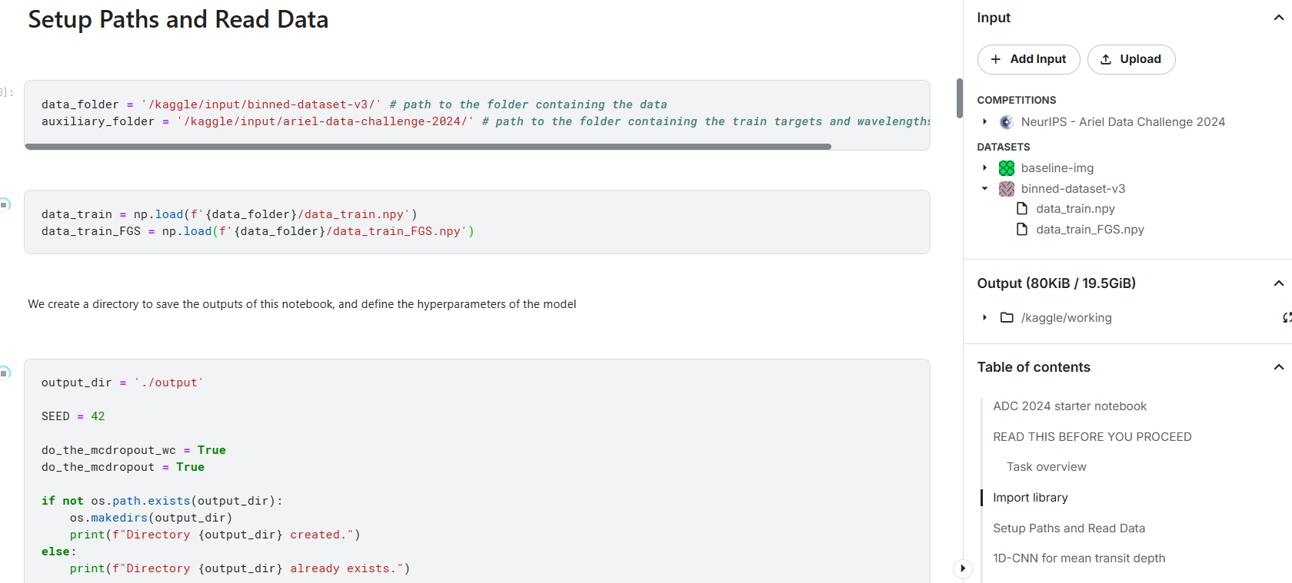
Data Preparation
We highly commend to preprocess data on your own again with corrected configurations in official notebook, as we have found several mistakes in the official notebook.
© kaggle君-sakura, 2024. All rights reserved.

Slide 13
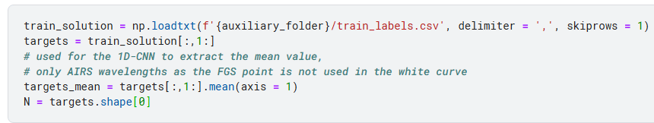
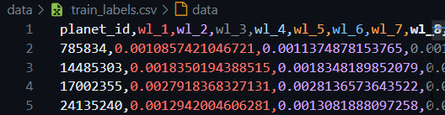
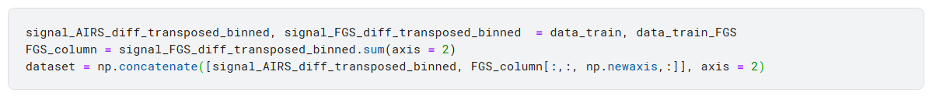
Data Preparation
1D-CNN for mean transit depth
AIRS-CH0
FGS1
Shape: (N_sample,N_wavelength)
Calculate mean without FGS1 i.e. wl_1
So, the sequence a bit differ from train_labels.csv.
We create the dataset by adding the FGS frame, crushed in one column, at the end of the AIRS data cube.
We sum up the pixels on the y-axis to transform the data into 2D images
© kaggle君-sakura, 2024. All rights reserved.

Slide 14
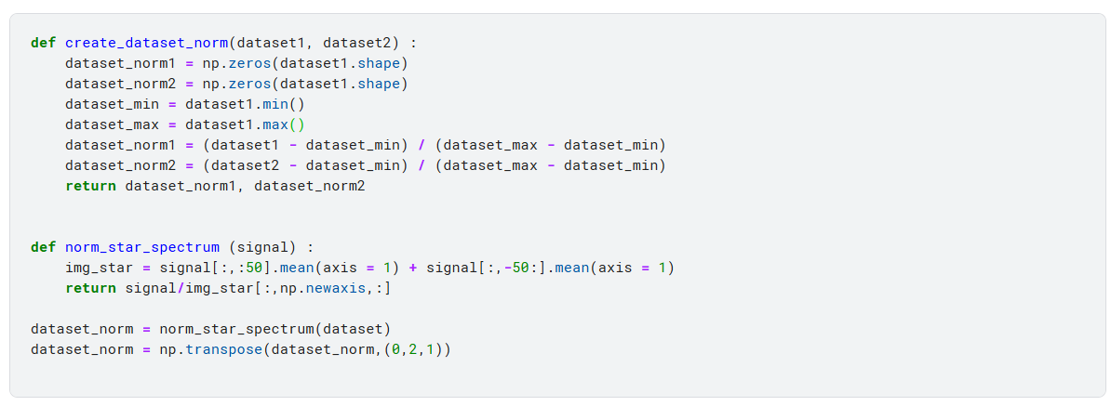
Data Preparation
We divide the images by the star flux assuming the first and last 50 instants belong to the out of transit.
The images are normalized using the star spectrum extracted from the images themselves.
Create_dataset_norm function seems to be not used in the notebook. Check it.
Out of Transit
Out of Transit
Transit
Star Spectrum Flux
不发生凌日时，恒星自己的光谱特征
© kaggle君-sakura, 2024. All rights reserved.

Slide 15
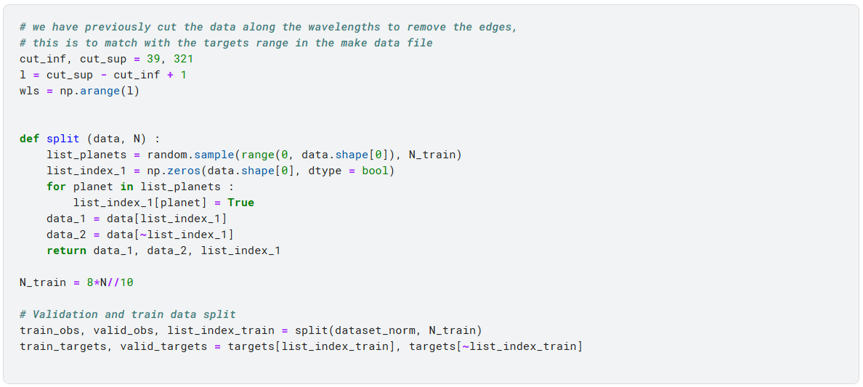
Data Preparation
Actually, if you are convinced with your model, you do not need test set (this notebook do not split test set either). Just run your code on the test set officially provided for scoring.
We start by computing a "white curve", that is actually the sum of the signal over the all image, as a function of time. We split the data and normalize the train/valid/test data.
Again, as mentioned before, this part is confusing. Try your own.
© kaggle君-sakura, 2024. All rights reserved.

Slide 16
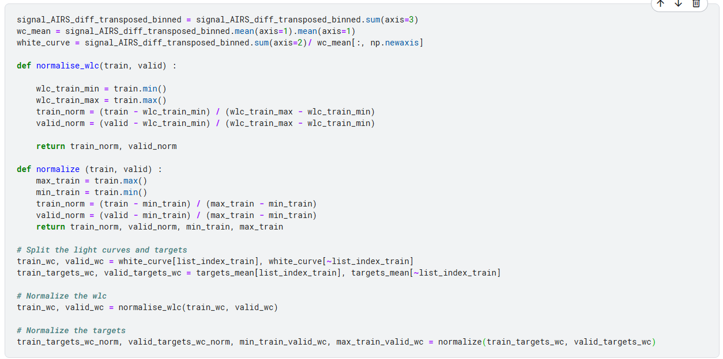
Data Preparation
© kaggle君-sakura, 2024. All rights reserved.

Slide 17
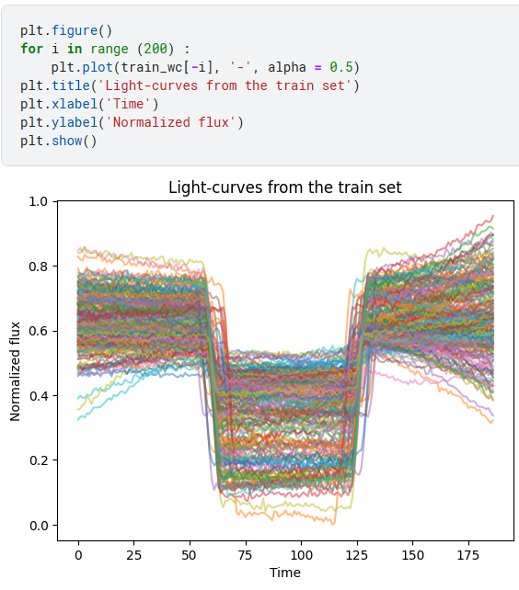
Data Preparation
In 1D CNN pipeline, the spectral dimension is normalized into a single dimension which is closely related the conception of flux.
200 samples in training set with shape (187,1)
© kaggle君-sakura, 2024. All rights reserved.

Slide 18
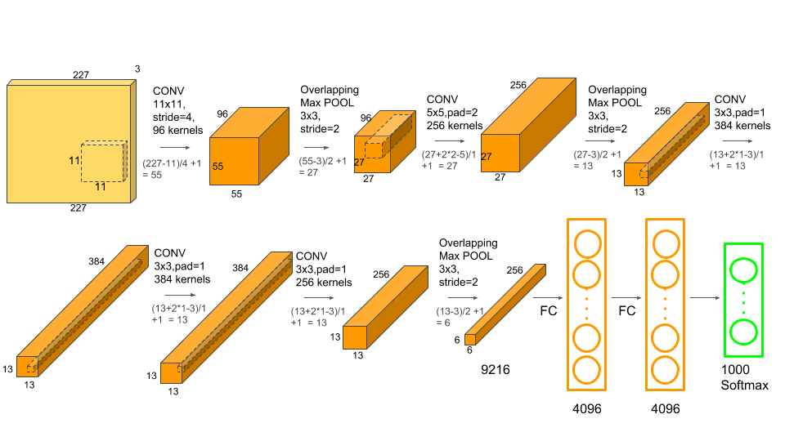
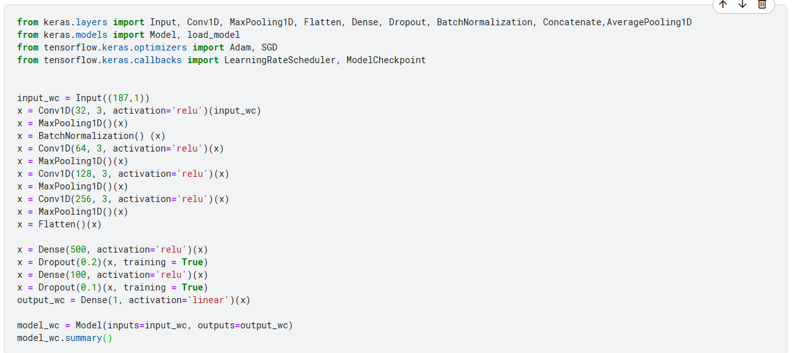
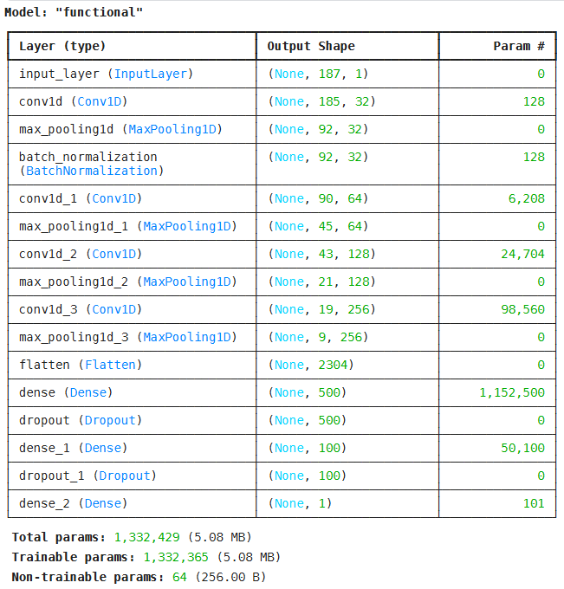
Train 1D CNN
In this notebook, CNNs are much similar to AlexNet (2012),
where they pass convolutional layer and then FC layers.
© kaggle君-sakura, 2024. All rights reserved.

Slide 19
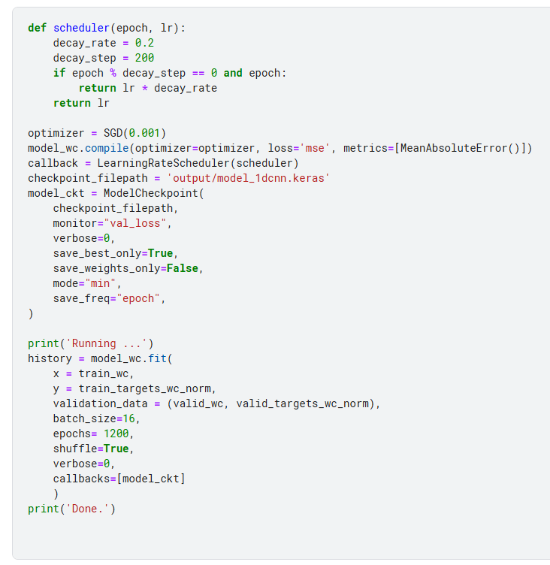
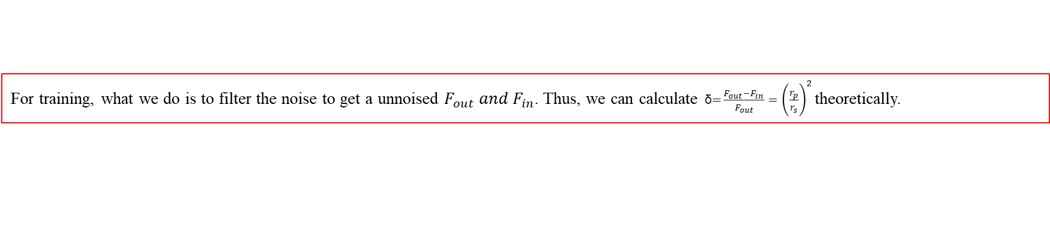
Train 1D CNN
For training, what we do is to filter the noise to get a unnoised $F_{out} and F_{in}$. Thus, we can calculate $\text{δ}\text{=}{\left.\frac{F_{out}−F_{in}}{F_{out}}=\left(\frac{r_{p}}{r_{s}}\right.\right)}^{2}$theoretically.
© kaggle君-sakura, 2024. All rights reserved.

Slide 20
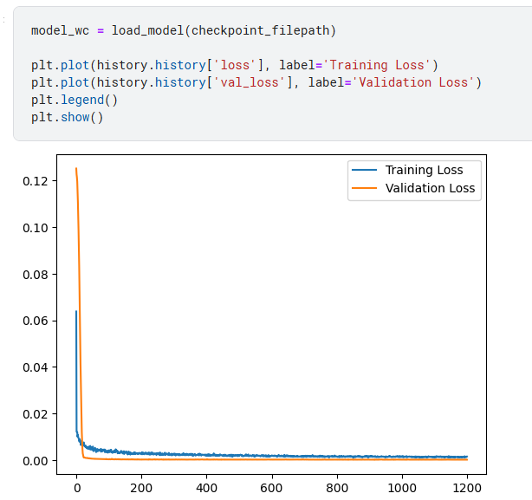
1D CNN Inference
© kaggle君-sakura, 2024. All rights reserved.

Slide 21
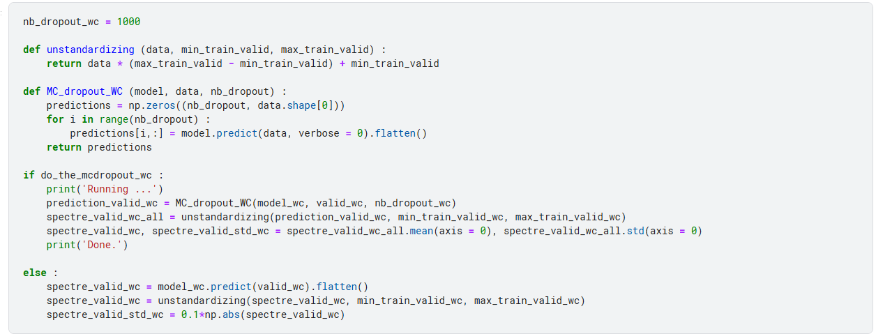
1D CNN Inference
Then, we perform the MC Dropout to obtain the mean prediction and the uncertainty associated. We choose to compute 1000 instances.
© kaggle君-sakura, 2024. All rights reserved.

Slide 22
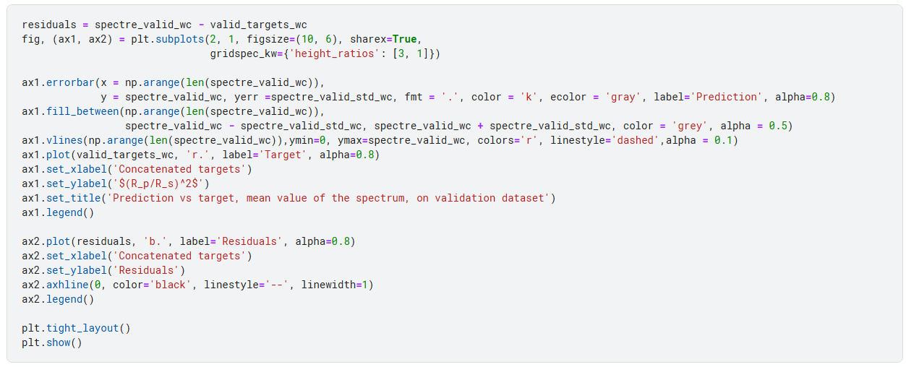
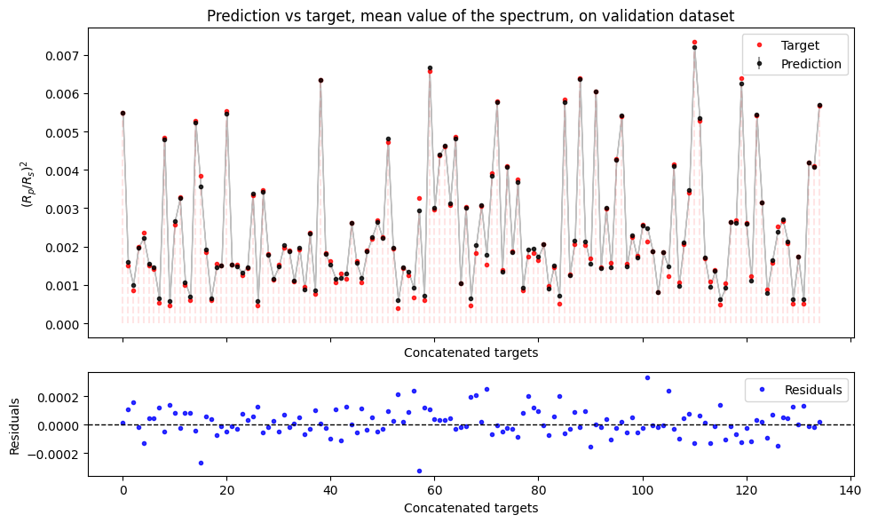
1D CNN Inference
© kaggle君-sakura, 2024. All rights reserved.

Slide 23
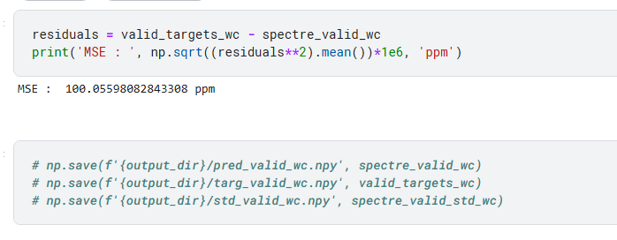
1D CNN Inference
© kaggle君-sakura, 2024. All rights reserved.

Slide 24
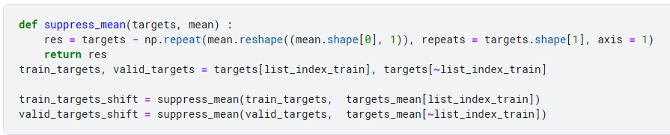
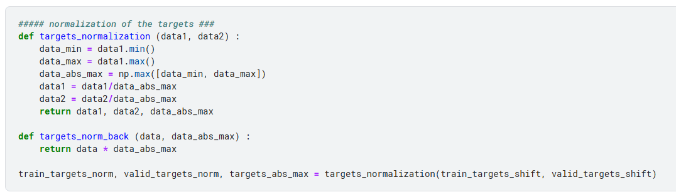
Preprocessing for 2D CNN
2D CNN for atmospheric features
We now remove the mean value (transit depth) of the spectra to keep the atmospheric features only
Note: we still sum spatial dimension.
We normalize the targets so that they range between -1 and 1, centered on zero
© kaggle君-sakura, 2024. All rights reserved.

Slide 25
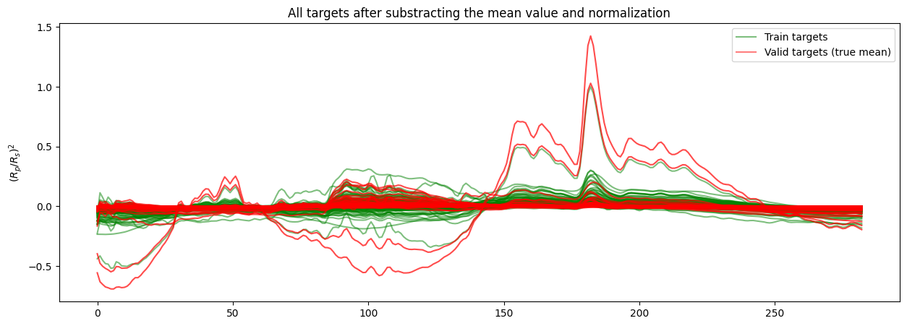
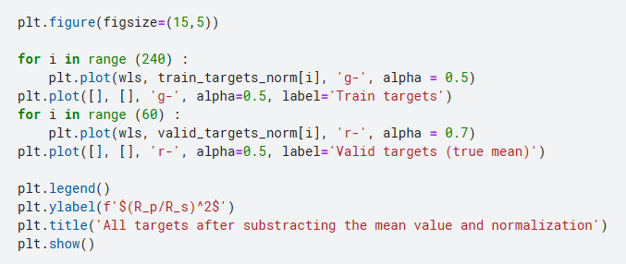
Preprocessing for 2D CNN
© kaggle君-sakura, 2024. All rights reserved.

Slide 26
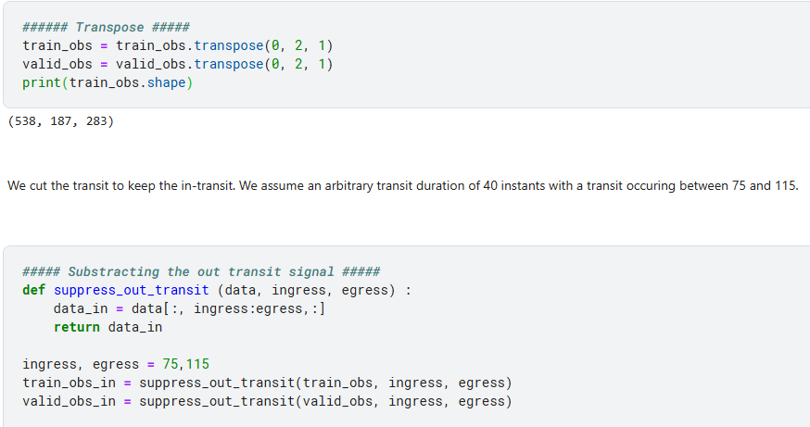
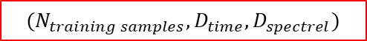
Preprocessing for 2D CNN
$$(N_{training samples},D_{time},D_{spectrel})$$
© kaggle君-sakura, 2024. All rights reserved.

Slide 27
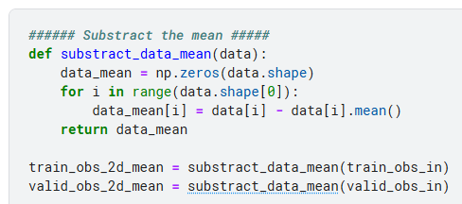
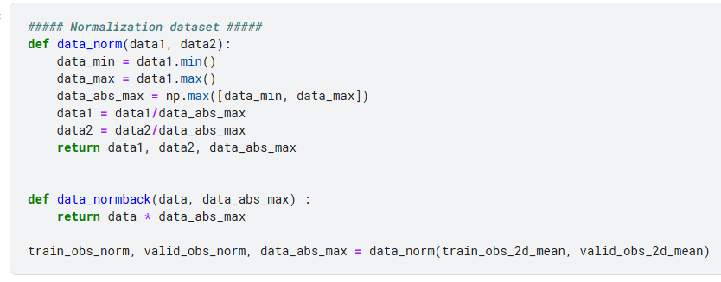
Preprocessing for 2D CNN
We remove the mean value of the in-transit to get relative data like the targets
We use the same normalization as for the targets, i.e. between -1 and 1 centered on zero
© kaggle君-sakura, 2024. All rights reserved.

Slide 28









Train 2D CNN
$$t$$
$$λ$$
$$Conv2D$$
$Shape:(3,1)$ * 32
$$MaxPooling2D$$
$Shape:(2,1)$
© kaggle君-sakura, 2024. All rights reserved.

Slide 29

Postprocessing and Visualisation
We obtain uncertainties on the predictions by computing a MCDropout.
© kaggle君-sakura, 2024. All rights reserved.

Slide 30


Postprocessing and Visualisation
This visualized picture confused me, just ignore it.
© kaggle君-sakura, 2024. All rights reserved.

Slide 31



Postprocessing and Visualisation
The value in this plot is not a standard ${\left.\left(\frac{r_{p}}{r_{s}}\right.\right)}^{2}$, we need norm back and add mean later.
np.arrange(len(wavelength))
Uncertainty should be displayed as box style like this example.
© kaggle君-sakura, 2024. All rights reserved.

Slide 32



Results
np.arrange(len(wavelength))
© kaggle君-sakura, 2024. All rights reserved.

Slide 33


Results
This plot style is bad. Use scatter plot or anything else.
MSE : 105.53292849547191 ppm
© kaggle君-sakura, 2024. All rights reserved.

Slide 34
Thanks for listening!

